Slide 1
Swing
Nguyễn Văn Khiết

Slide 2
Content
Introduction to awt
Introduction to Swing
Swing components

Slide 3
Introduction to awt
The AWT was designed to provide a common set of tools for GUI design that could work on a variety of platforms.
An API to develop GUI or window-based applications in java.

Slide 4
Introduction to awt
Most of the awt components inherit from java.awt.Component.
Some awt components:
  Label
  Button
  Canvas
  CheckBox
  Container
  List
  Scrollbar
  …

Slide 5
Introduction to Swing
Java Swing is used to create window-based applications. It is built on the top of AWT (Abstract Windowing Toolkit) API.
Unlike AWT, Java Swing provides platform-independent and lightweight components.
Most of the swing components inherit from JComponent.

Slide 6
Introduction to Swing
Swing components:
  JComponent
  JLabel
  JButton
  JList
  JMenuBar
  JOptionPane
  JPanel
  JFrame
  JApplet
  …

Slide 7
Swing Packages
javax.swing
javax.swing.border
javax.swing.event
javax.swing.filechooser
javax.swing.plaf
javax.swing.plaf.basic
javax.swing.plaf.metal
javax.swing.plaf.multi

Slide 8
Swing Packages
javax.swing.colorchooser
javax.swing.table
javax.swing.text
javax.swing.text.html
javax.swing.text.html.parser
javax.swing.text.rtf
javax.swing.tree
javax.swing.undo

Slide 9
Working with Swing Components
JPanel
JFrame
JWindow
Border
Other swing components

Slide 10
JPanel
JPanel object is a container component, this means we can put other components into a JPanel object.
A panel uses a layout manager to position and size its components.
Method add of JPanel is used to put components into a JPanel object.

Slide 11
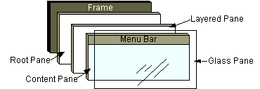
JFrame
A Frame is a top-level window with a title and a border.

Slide 12
JFrame
JFrame objects displayed through a JRootPane object..
A root pane has four part:
  Glass Pane
  Layered Pane
  Content Pane
  Optional Menu bar

Slide 13
JFrame
Content Pane: a place to contain all visible components of JFrame.
ContentPane is a JPanel object.
  JPanel getContentPane()
  setContentPane(JPanel contentPane)
Menu bar for Jframe
  getJMenuBar()
  setJMenuBar()

Slide 14
JWindow
JWindow is similar to JFrame but JWindow has no title bar.
Usually a JWindow object is used to display a message or a splash screen

Slide 15
Swing Component Border
Borders are objects that know how to draw the edges of Swing components.
Borders are useful not only for drawing lines and fancy edges, but also for providing titles and empty space around components.

Slide 16
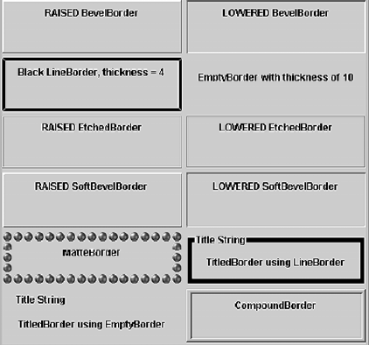

Slide 17
Other swing components
http://docs.oracle.com/javase/tutorial/uiswing/components/

